Slide 1
March 24, 2014
Objectives: Engage in a range of collaborative discussions with diverse partners.
I CAN STATEMENTS:
I can communicate and respond to ideas about a variety of topics during discussions.
Topic: Poetry
Finish this poem in a way I haven’t heard. (Please be appropriate)
Roses are red.
Violets are blue.
Silent Uninterrupted Reading: Grab your book and start reading. Remember, if you aren’t reading, you aren’t getting points.

Slide 2
Reminders/Schedule
4th Quarter Begins RIGHT NOW
How excited are we?
Turn in Part III Projects
If you handed it in online (through Google Apps) please hand in a sheet of paper with your name and the project you picked.
Read and Journals
William Duffy’s Farm
Poetry Vocabulary

Slide 3
Reading Strategies
Make Predictions
Visualize
Ask and Answer Questions
Retell and Summarize
Connect the Text to Life Experiences, Other Texts, or Prior Knowledge

Slide 4
Oral Journal
Prompt: What is going on in the book that is similar to something that has happened to you in your life? Be specific. Be ready to share.

Slide 5
April 2, 2014
Objectives: Engage in a range of collaborative discussions with diverse partners.
I CAN STATEMENTS:
I can communicate and respond to ideas about a variety of topics during discussions.
Topic: Poetry
Tell me about a place you go that makes your realize how wonderful nature is. Someplace that is your own and where you can truly relax. 25+ Words
Silent Uninterrupted Reading: Grab your book and start reading. Remember, if you aren’t reading, you aren’t getting points.

Slide 6
Reminders/Schedule
Can’t think of anything
Read and Journals
Poetry Vocabulary

Slide 7
Things to keep
Starters
Comma Rule Sheet
Part III Projects

Slide 8
Reading Strategies
Make Predictions
Visualize
Ask and Answer Questions
Retell and Summarize
Connect the Text to Life Experiences, Other Texts, or Prior Knowledge

Slide 9
Written Journal
Prompt: Look for examples of color. Write down each time you read something about the color of objects, scenery, and characteristics.

Slide 10
Poetry Vocabulary
Write the definition and the picture to help you remember the term.

Slide 11
April 3, 2014
Objectives: Engage in a range of collaborative discussions with diverse partners.
I CAN STATEMENTS:
I can communicate and respond to ideas about a variety of topics during discussions.
Topic: Poetry
Who can come up with the most words that rhyme in 2 minutes?
Silent Uninterrupted Reading: Grab your book and start reading. Remember, if you aren’t reading, you aren’t getting points.

Slide 12
Reminders/Schedule
Less chit chat + being respectful = a happy Mr. Hobbs.
Read and Journals
Poetry Vocabulary
Poetry Term Project

Slide 13
Reading Strategies
Make Predictions
Visualize
Ask and Answer Questions
Retell and Summarize
Connect the Text to Life Experiences, Other Texts, or Prior Knowledge

Slide 14
Oral Journal
Prompt: Conflict is a major part of a novel. What major issue is your character dealing with right now? What advice could you give the character? Remember, I’m going to dig until I get the answers I’m looking for. Be prepared.

Slide 15
Poetry Vocabulary
Write the definition and the picture to help you remember the term.

Slide 16
Poetry Definition Guide
Fill out and Decorate the Poetry Definition Guide.

Slide 17
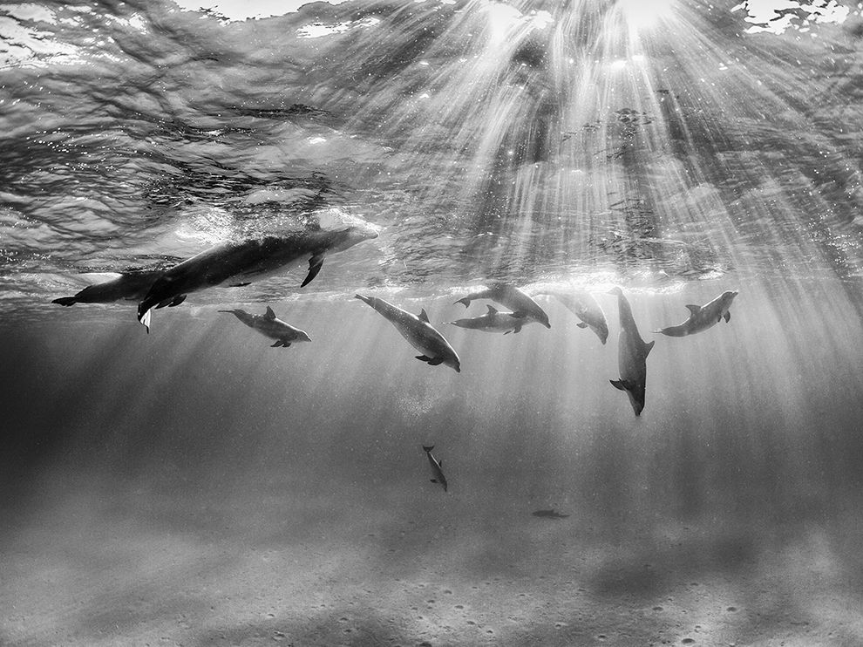
Use at least one Metaphor and one Simile to describe this picture. 30+ Words.

Slide 18
Reminders/Schedule
Less chit chat + being respectful = a happy Mr. Hobbs.
Read and Journals
Poetry Vocabulary
Poetry Term Project

Slide 19
Reading Strategies
Make Predictions
Visualize
Ask and Answer Questions
Retell and Summarize
Connect the Text to Life Experiences, Other Texts, or Prior Knowledge

Slide 20
Written Journal (April 4 #2)
Prompt: Retell the what’s going on in your book from another character’s point of view.

